Slide 1
Ambient Light with Harman Pulse 2

Slide 2
What
Implementation of Ambient Lighting for portable devices using Harman Pulse technology
Get Ambient Light on the go for any content your are viewing on your laptop
Uses Harman Pulse 2 display capabilities
Works with one or multiple speakers simultaneously
Automatic brightness adjustments using luminescence sensors and flowthings.io API

Slide 3
Why
Ambient Light is cool because…
Available only as part of high-end TVs or as a separate device
Get it for free if you have Harman Pulse 2 speaker(s)

Slide 4
Demo
Live

Slide 5
Demo
Dark Room

Slide 6
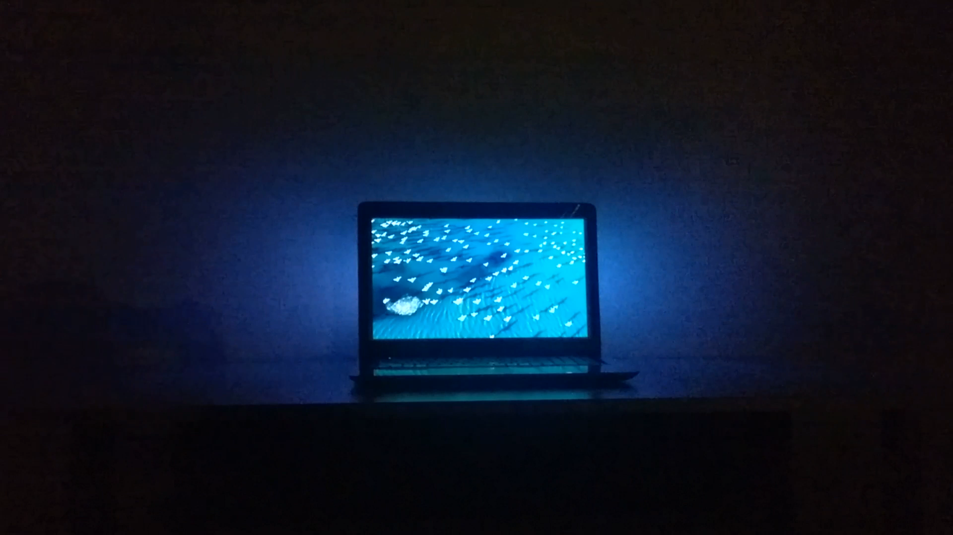

Slide 7
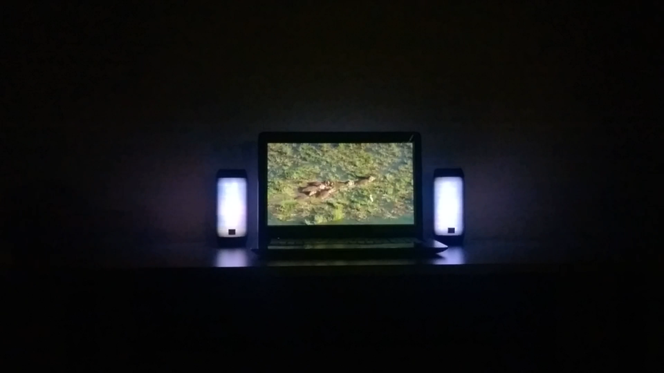

Slide 8
Demo
Flowthings.io integration

Slide 9
How
Device
control
Additional Speaker(s)
pairing
Main Speaker
control
lux json
flowthings.io
control
image and brightness control
sound
luminescence data
lux

Slide 10
Processing flow

Slide 11
What’s next

Slide 12
Questions

